Slide 2
INF10025
Data Management and Analytics
Week 03 - Part 2
Update & Delete queries

Slide 3
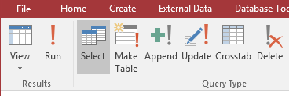
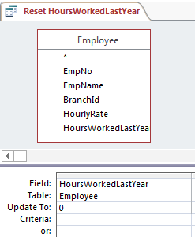
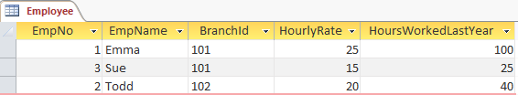
Update Query
An Update Query allows you to change the value of a field(s) for many records at one time.
Example: We can set all employees HoursWorkedLastYear to zero

Slide 4
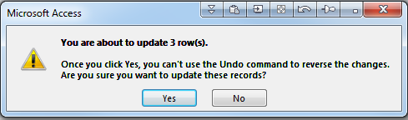
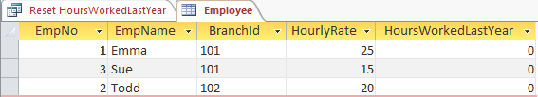
Update Query
When the query is run, Access gives a warning about impeding changes to the table.
(These warnings can be suppressed via Access Settings)
Once you say Yes, the records are changed.

Slide 5
Update Query
Warning:
There is no way to undo an update query. Ctrl Z is useless
Be careful before you execute an Update Query.
E.g. It is possible to update every row in a 10 million row table.
If you specify a criteria incorrectly and do not test you query first, this could have catastrophic results.
It is strongly suggested that you take backups of your data – especially before executing such a query.

Slide 6


Update Query
This example shows how the current Hourly Rate value can be
increased by $2.50 for each of the employees.
The calculation includes the name of the field.

Slide 7
Delete Query
A Delete Query is similar to an Update Query.
Rows are permanently deleted from a table.
These is no undo facility.
Backups of database tables are crucial.

Slide 8
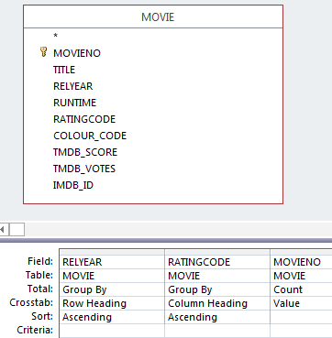
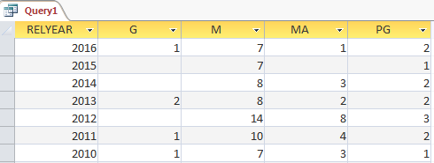
CrossTab Query
A Cross Tab Query is similar to a Pivot Table in Excel.
A crosstab query performs an aggregation (sum, count…) & groups the results by two sets of values - one set of values on the side of the datasheet and the other set of values across the top.

Slide 9
SQL
Almost all Relational Databases use SQL (structured query language) to manipulate objects and data within the database.
This is hidden from you when you use Access because
  Access uses a Graphical User Interface.
  Many non-computer savvy people would have trouble understanding SQL
However, each time you Create a Table or Design a Query, Access is generating SQL behind the scenes.
You can view the SQL that is being generated by Access for a number of actions you perform.
(We will be writing some SQL without help from Access in future weeks)

Slide 10
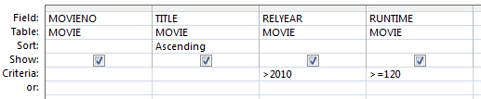


SQL
This is an example of a simple query design screen
The bottom right corner of the screen has an SQL icon.
Click the icon to reveal the SQL statement.

